Slide 1
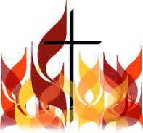
RTMC
Sermon
by
Rev. Paul Royappa
May 15, 2016
The Church with
ttttttttttttttt
llllllllllllllllllllllllllllllllllllllllllllllllllllllllllllllllllllllllllllllllllllllllllllllllllllllllllllllllllllll

Slide 2
No.1-
Old Testament
Feast of Weeks
Feast of First Fruits
Leviticus 23 & Deu 16
New Testament
Pentecost
Acts 2

Slide 3
No.2
What is the significance of Pentecost in Acts 2?
Genesis 1:2
Psalm 51:11
1 Samuel 11:6
1 Samuel 16:14

Slide 5
Acts 10:44 & 45
44 While Peter was still speaking these words, the Holy Spirit came on all who heard the message.
45 The circumcised believers who had come with Peter were astonished that the gift of the Holy Spirit had been poured out even on Gentiles.

Slide 6
No.3
God’s Purpose at Pentecost

Slide 7
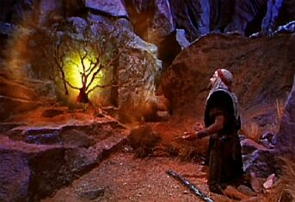
Acts 2
Exodus 3&4
Tongues of Fire
Burning Bush

Slide 8
What is your Pentecost Experience?
Witnessing Power

