Slide 1
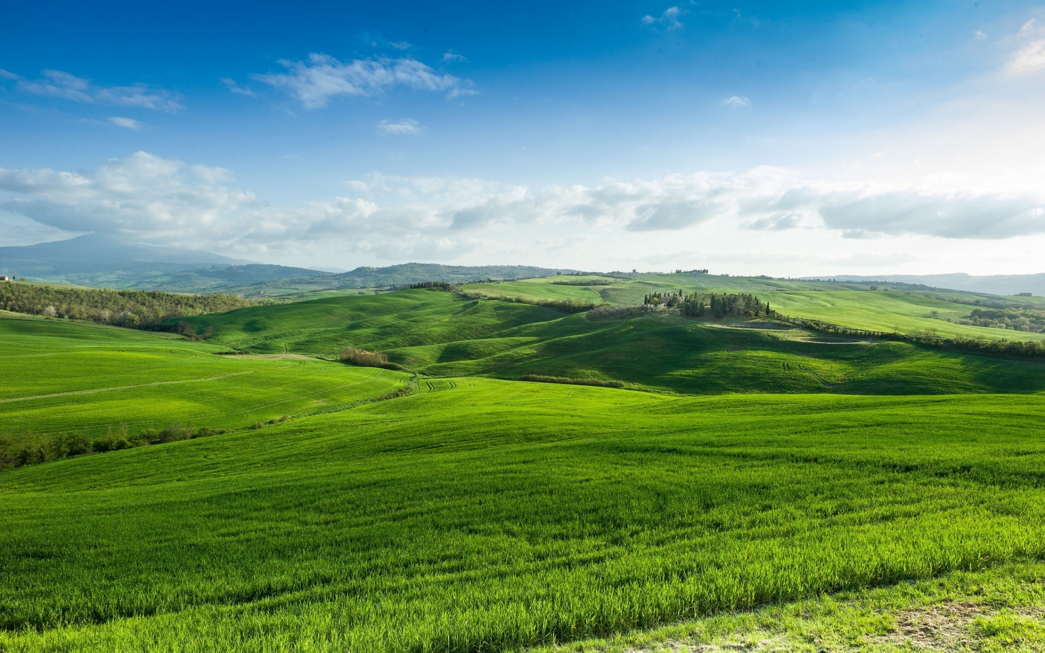
Scripture Reading- Leviticus 25:1-7
The Lord said to Moses at Mount Sinai, ² “Speak to the Israelites and say to them: ‘When you enter the land I am going to give you, the land itself must observe a Sabbath to the Lord. ³ For six years sow your fields, and for six years prune your vineyards and gather their crops. ⁴ But in the seventh year the land is to have a year of Sabbath rest, a Sabbath to the Lord. Do not sow your fields or prune your vineyards. ⁵ Do not reap what grows of itself or harvest the grapes of your untended vines. The land is to have a year of rest. ⁶ Whatever the land yields during the Sabbath year will be food for you—for yourself, your male and female servants, and the hired worker and temporary resident who live among you, ⁷ as well as for your livestock and the wild animals in your land. Whatever the land produces may be eaten.

Slide 2
By Rev. Paul Royappa

Slide 3
No.1- This is our Father’s World

Slide 4
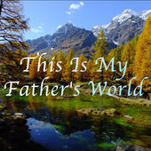
This is my Father's world,
and to my listening ears
All nature sings, and round me rings
the music of the spheres.
This is my Father's world:
I rest me in the thought
of rocks and trees, of skies and seas;
His hand the wonders wrought.
Stewards of Creation

Slide 5
Psalm 24:1- "The earth is the LORD’s, and everything in it.”
Leviticus 25: 1& 23- But in the seventh year the land is to have a Sabbath of rest, a Sabbath to the Lord. The land must not be sold permanently, because the land is mine and you reside in my land as foreigners and strangers.
Colossians 1:16 - For in him all things were created: things in heaven and on earth, visible and invisible, whether thrones or powers or rulers or authorities; all things have been created through him and for him.

Slide 6
No.2- What is our role as stewards in God’s creation?

Slide 7
This is my Father's world.
O let me ne'er forget
that though the wrong seems oft so strong,
God is the ruler yet.
This is my Father's world:
why should my heart be sad?
The Lord is King; let the heavens ring!
God reigns; let the earth be glad!
Stewards of Creation

Slide 8
No.2- What is our role as stewards in God’s creation?
Genesis 2:15 - The Lord God took the man and put him in the Garden of Eden to work it and take care of it.

Slide 11
Are we stewards of God’s message of Redemption in Creation and New heaven and new Earth?
&
Application

Slide 12
Stewards of Creation

