Slide 1
Scripture Reading
Prophetess

Slide 2
Sermon
Principles of Growing Old
By Rev. Paul Royappa

Slide 3
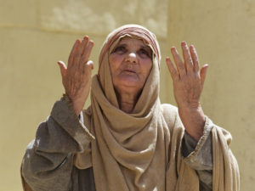
Principle No.1
‘Thankfulness to God’
Lu 2:38
‘Coming up to them at that very moment. Anna gave thanks to God’
Principles of Growing old

Slide 4
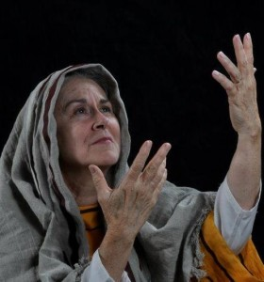
Principle No.2
Godliness
Lu 2:37
She never left the temple but worshipped night and day, fasting and praying
Principles of Growing old

