Slide 1
Watch Night Service- Dec 31, 2015
Theme
‘Promises to count on’
2 Biblical Principles for 2016
By Rev. Paul Royappa
Genesis 41:50-52

Slide 2
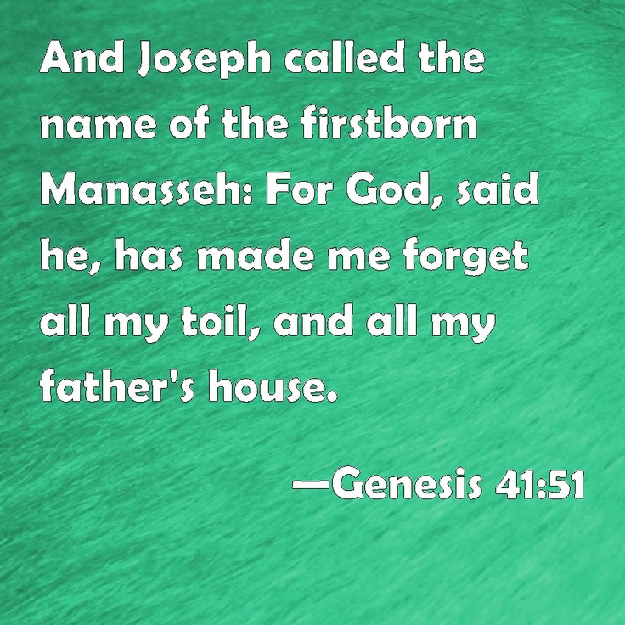
From
Biblical Principle
Genesis 41:51
No.1:Manasseh
Do not live with the trouble of the past- Forget

Slide 4
From
Biblical Principle
Gen 41:52
No.2: Ephraim
Trust and Count on God for 2016 and future

Slide 6
From
Biblical Principle
Gen 41:52
No.2: Ephraim
Trust and Count on God’s promises for 2015 and future

Slide 7
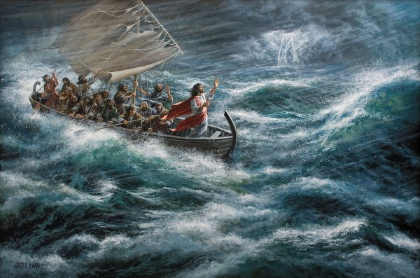

Slide 8
Application
‘Promises to count on’
2 Biblical Principles for 2016
Manasseh - Ephraim
Genesis 41:50-52

