Slide 1
Scripture Passage : Matthew 5:1-10
1 Now when Jesus saw the crowds, he went up on a mountainside and sat down. His disciples came to him, 2 and he began to teach them. He said: 3 “Blessed are the poor in spirit, for theirs is the kingdom of heaven. 4 Blessed are those who mourn, for they will be comforted. 5 Blessed are the meek, for they will inherit the earth. 6 Blessed are those who hunger and thirst for righteousness, for they will be filled. 7 Blessed are the merciful, for they will be shown mercy. 8 Blessed are the pure in heart, for they will see God. 9 Blessed are the peacemakers, for they will be called children of God. 10 Blessed are those who are persecuted because of righteousness, for theirs is the kingdom of heaven.

Slide 2
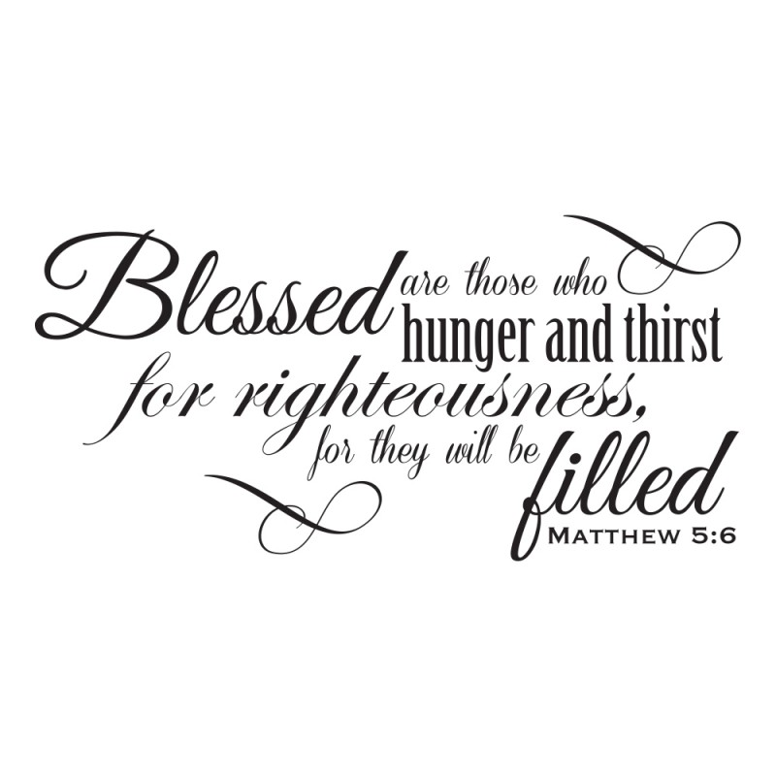
Sermon Theme
‘Nurturing Spiritual Appetite’
By Rev. Paul Royappa

Slide 3
‘Nurturing Spiritual Appetite’
No.1- What is righteousness
in Mat 5:6?

Slide 4
First Group
Second Group
Matthew 5:7-10

Slide 5
‘Nurturing Spiritual Appetite’
No.2-What does it mean to hunger and thirst for righteousness?

Slide 6
No.2-What does it mean to hunger and thirst for righteousness?

