Slide 1
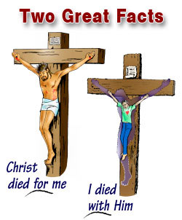
March 13, 2016
Sermon Topic
Living the Crucified Life
By Rev. Paul Royappa

Slide 2
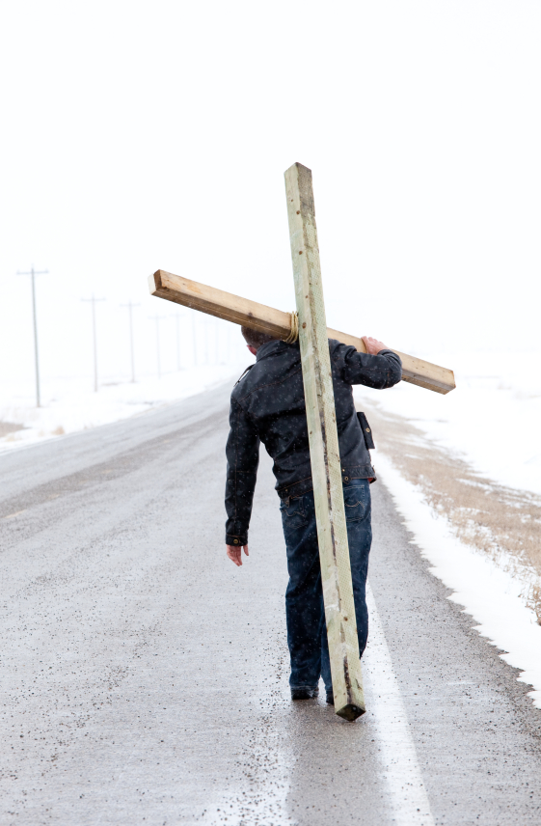
Crucified life means breaking our Will and doing God’s will daily
1 Thessalonians 5:23

Slide 3
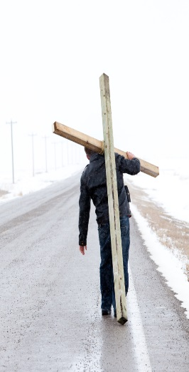
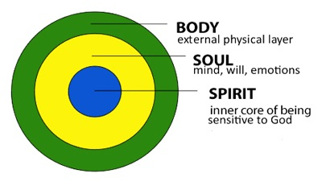
Man
1 The 5:23
Living the crucified life

Slide 4
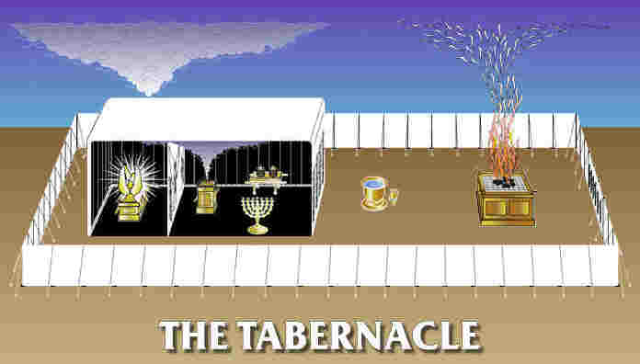
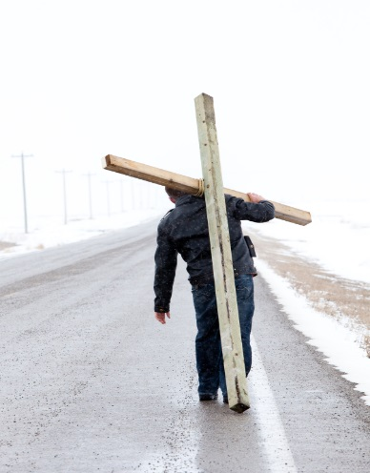
Curtain
Spirit
Soul
Body

