Slide 1
Scripture Reading
John 15:1-11
“I am the true vine, and my Father is the gardener. 2 He cuts off every branch in me that bears no fruit, while every branch that does bear fruit he prunes so that it will be even more fruitful. 3 You are already clean because of the word I have spoken to you.
4 Remain in me, as I also remain in you. No branch can bear fruit by itself; it must remain in the vine. Neither can you bear fruit unless you remain in me.
5 “I am the vine; you are the branches. If you remain in me and I in you, you will bear much fruit; apart from me you can do nothing.

Slide 2
6 If you do not remain in me, you are like a branch that is thrown away and withers; such branches are picked up, thrown into the fire and burned.
7 If you remain in me and my words remain in you, ask whatever you wish, and it will be done for you. 8 This is to my Father’s glory, that you bear much fruit, showing yourselves to be my disciples.
9 “As the Father has loved me, so have I loved you. Now remain in my love. 10 If you keep my commands, you will remain in my love, just as I have kept my Father’s commands and remain in his love. 11 I have told you this so that my joy may be in you and that your joy may be complete.

Slide 3
Sermon Topic
Living a Fruitful Life
By Rev. Paul Royappa

Slide 4
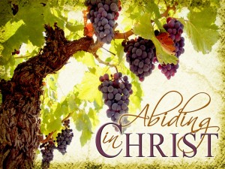
No.1- What is the key to bearing fruit as a Christian

Slide 5
No 2. The consequences of
Not abiding in Christ
John 15:4,6 & 11
Living a Fruitful Life

