Slide 1
Scripture Reading : 2 Corinthians 5:1-10
1 For we know that if the earthly tent we live in is destroyed, we have a building from God, an eternal house in heaven, not built by human hands. 2 Meanwhile we groan, longing to be clothed instead with our heavenly dwelling, 3 because when we are clothed, we will not be found naked. 4 For while we are in this tent, we groan and are burdened, because we do not wish to be unclothed but to be clothed instead with our heavenly dwelling, so that what is mortal may be swallowed up by life. 5 Now the one who has fashioned us for this very purpose is God, who has given us the Spirit as a deposit, guaranteeing what is to come.
6 Therefore we are always confident and know that as long as we are at home in the body we are away from the Lord. 7 For we live by faith, not by sight. 8 We are confident, I say, and would prefer to be away from the body and at home with the Lord. 9 So we make it our goal to please him, whether we are at home in the body or away from it. 10 For we must all appear before the judgment seat of Christ, so that each of us may receive what is due us for the things done while in the body, whether good or bad.

Slide 2
Richmond Town Methodist Church
Sermon Topic
‘Life beyond Physical Journey’
2 Cor 5:1-10
By Rev. Paul Royappa

Slide 3
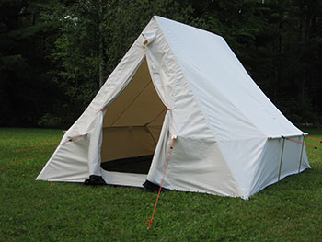
No. 1- The nature of our earthly body
2 Cor 5:1 & 4
Body =Tent

Slide 4
No. 2- Unshakable Confidence in
life beyond death
V.8
2 Cor 5:8: We are confident, I say, and would prefer to be away from the body and at home with the Lord.

Slide 5
2 Cor 5:5
Now the one who has fashioned us for this very purpose is God, who has given us the Spirit as a deposit, guaranteeing what is to come.
Romans 8:11
And if the Spirit of him who raised Jesus from the dead is living in you, he who raised Christ from the dead will also give life to your mortal bodies because of his Spirit who lives in you.

Slide 6
No. 3: What is the aim of our life in light of our eternal destiny
Vs. 9& 10
2 Cor 5: 9&10 - So we make it our goal to Please God, whether we are at home in the body or away from it. For we must all appear before the judgment seat of Christ, that each one may receive the things done in the body, according to what he has done, whether good or bad

