Slide 1
Scripture Reading

Slide 2
Theme: Human Frailty & Finality
2 Cori 12:7-10
By Rev. Paul Royappa

Slide 3
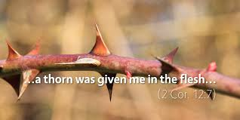
Human Frailty or Weakness
No 1- Human weakness comes from
Confusing circumstances
2 Cor 12: 7 because of these surpassingly great revelations. Therefore, in order to keep me from becoming conceited, I was given a thorn in my flesh, a messenger of Satan, to torment me.

Slide 4
Human Frailty or Weakness
No 2- Human weakness comes from
continuing pain
2 Cor 12: 2 & 8

