Slide 1
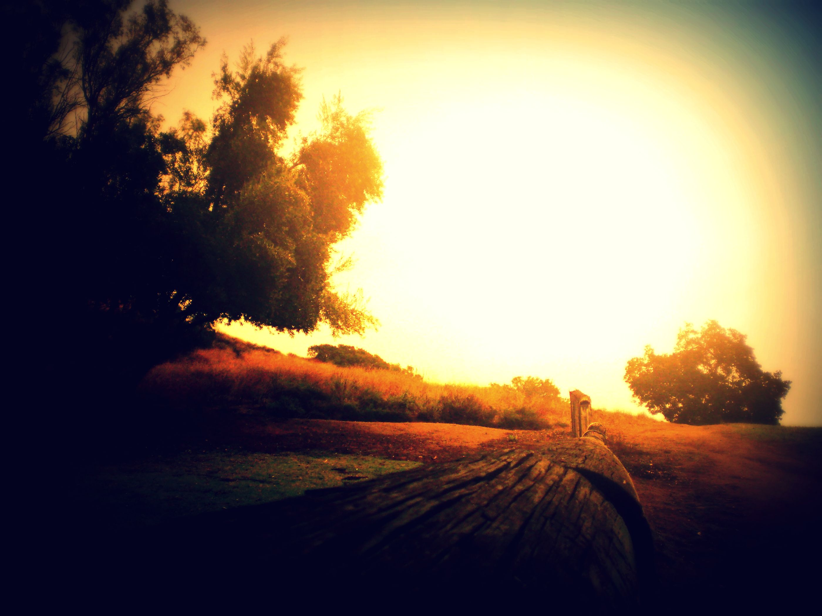
Theme
‘Hope of Resurrection’
Living hope through the resurrection of Christ
1 Peter 1:1-9
By Rev. Paul Royappa

Slide 2
No.1
They received Living Hope
V.3

Slide 3
No.2
How they received this
New birth
V.3

Slide 4
No.3
They received inheritance
V.4

Slide 5
No.4
They were shielded by God’s Power
V.5

