Slide 1
Sermon Topic
Jan 3, 2016
God’s Universal Rule & Personal Care, Love and Promises
Isaiah 41:1-13
By Rev. Paul Royappa

Slide 2
Sermon
No.1: God’s Universal Rule
Isaiah 41:1-7

Slide 3
Sermon
No.2: God’s Personal Care & Love
Isaiah 41:8-9

Slide 4
9
Kfkdakl;fkldks;a’afffl;alfkas;lfkldsfksdkf’;ldskf

Slide 5
Sermon
No.3: God’s Promises
Isaiah 41: 10-13

Slide 6
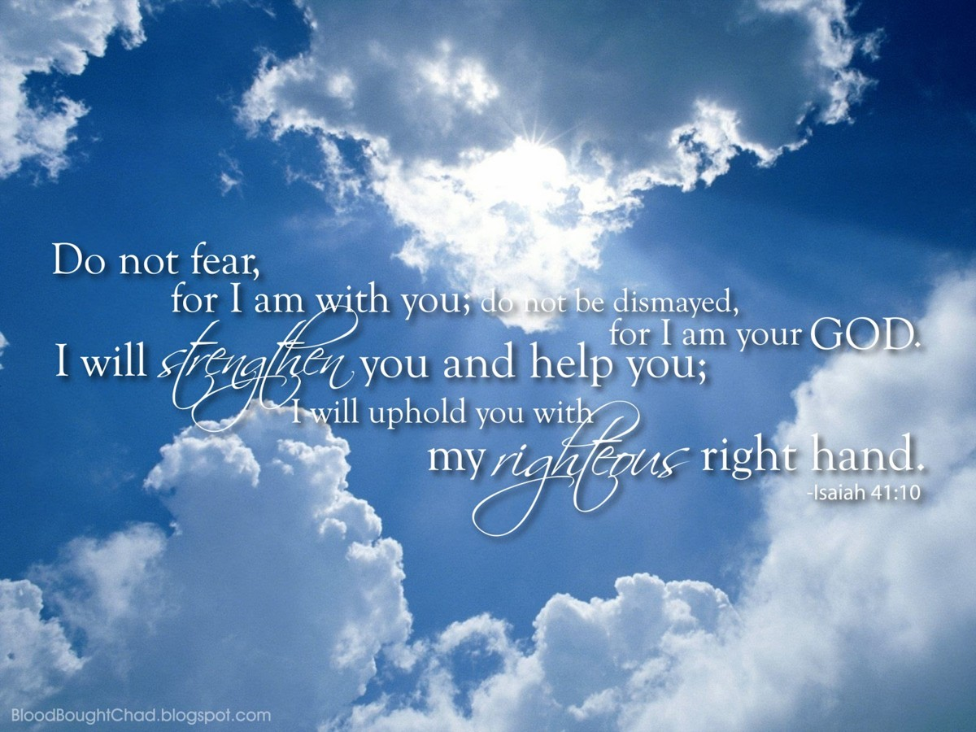
God Promises Security

Slide 7
God’s Promises
Isaiah 41: 11-13
11 “All who rage against you will surely be ashamed and disgraced; those who oppose you will be as nothing and perish.12 Though you search for your enemies, you will not find them. Those who wage war against you will be as nothing at all.13 For I am the LORD your God who takes hold of your right hand and says to you, Do not fear; I will help you.
God Promises Strength for today and bright hope for tomorrow (2016)

