Slide 1
Scripture Reading -Malachi 3:6-12
6 “I the Lord do not change. So you, the descendants of Jacob, are not destroyed. 7 Ever since the time of your ancestors you have turned away from my decrees and have not kept them. Return to me, and I will return to you,” says the Lord Almighty.“ But you ask, ‘How are we to return?’8 “Will a man rob God? Yet you rob me.“ But you ask, ‘How are we robbing you?’ “In tithes and offerings. 9 You are under a curse—your whole nation—because you are robbing me. 10 Bring the whole tithe into the storehouse, that there may be food in my house. Test me in this,” says the Lord Almighty, “and see if I will not throw open the floodgates of heaven and pour out so much blessing that there will not be room enough to store it. 11 I will prevent pests from devouring your crops, and the vines in your fields will not drop their fruit before it is ripe,” says the Lord Almighty. 12 “Then all the nations will call you blessed, for yours will be a delightful land,” says the Lord Almighty.

Slide 2
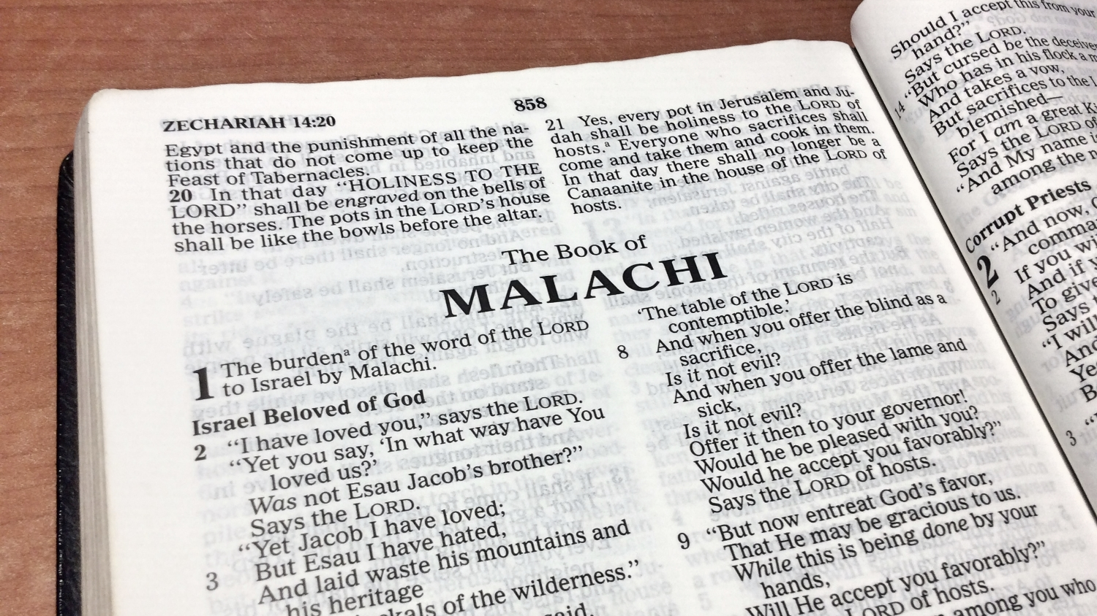
Sermon Topic
‘Give God an opportunity to bless you’
By Rev. Paul Royappa

Slide 3
No.1- No.1- Tithing is an opportunity that brings God’s blessings to you
Malachi 3:8
“Will a man rob God? Yet you rob me.“ But you ask, ‘How are we robbing you?’ “In tithes and offerings.

Slide 4
No.2-No.2- Offering is an opportunity that brings God’s blessings to you
Malachi 3:8
“Will a man rob God? Yet you rob me.“ But you ask, ‘How are we robbing you?’ “In tithes and offerings.

Slide 5
No.3 - Sacrificial Thank offering an opportunity that brings God’s blessings you
Malachi 3:10-12
10 Bring the whole tithe into the storehouse, that there may be food in my house. Test me in this,” says the Lord Almighty, and see if I will not throw open the floodgates of heaven and pour out so much blessing that there will not be room enough to store it. 11 I will prevent pests from devouring your crops, and the vines in your fields will not drop their fruit before it is ripe,” says the LORD Almighty. 12 “Then all the nations will call you blessed, for yours will be a delightful land,” says the LORD Almighty.

Slide 6
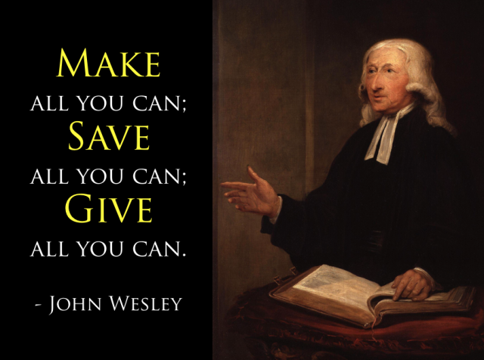
GET
Founder of the Methodist Church

