Slide 1
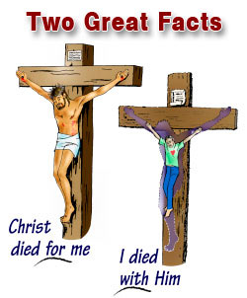
RTMC
Feb 28, 2016
Sermon Topic
Dying with Christ Daily
By Rev. Paul Royappa

Slide 2
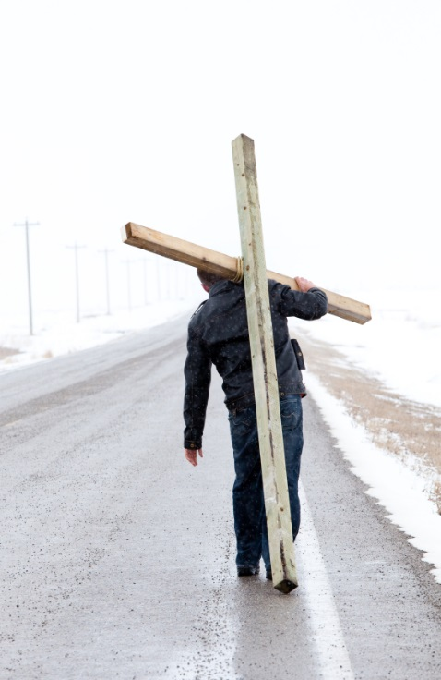
No.1. Die with Christ means
hate your soul life daily
Mat 10:39; 16:25; Luke 9:24; 17:33 Mark 8:35; John 12:25
Dying with Christ Daily

Slide 3
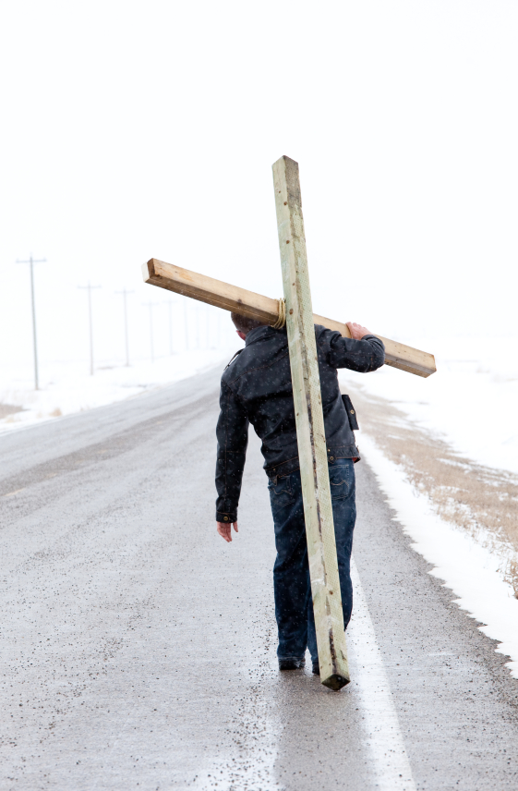
No.2-Die with Christ means breaking our Will and doing God’s will daily
1 Thessalonians 5:23

Slide 4
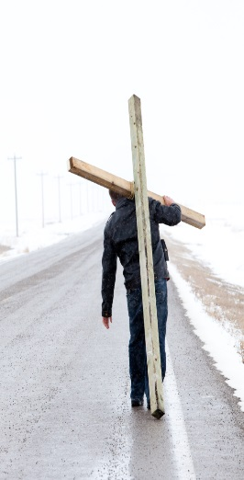
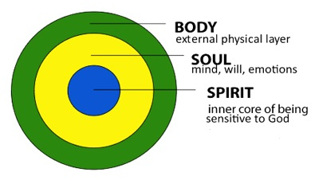
Man
1 The 5:23
Dying with Christ daily

Slide 5
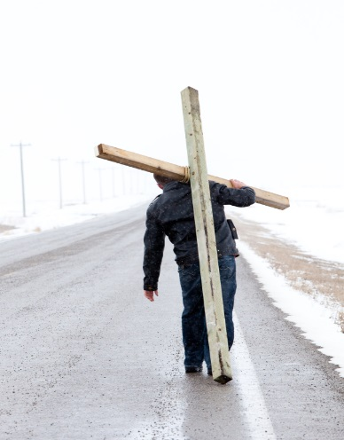
Curtain
Spirit
Soul
Body

