Slide 1
Sermon Topic
‘A life of Endurance’
Hebrews 12:1-3
By Rev. Paul Royappa

Slide 2
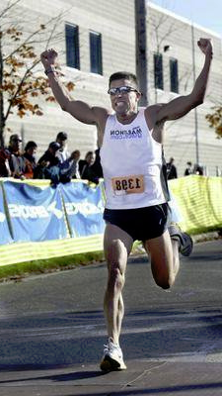
No.1- Run the race with endurance
Hebrews 12:1

Slide 3
No.2- Motivation to endure
Heb 11& 12:1

Slide 4
No.3- Throw Off
Heb 12:1

Slide 5
No.4- Fix your eyes on Christ who endured
Hebrews 12:2 &3

